Slide 1

RTL - Compilers - OS Kernels
And many other things in between

Slide 2


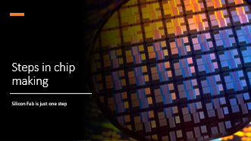
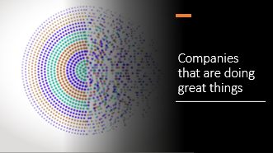

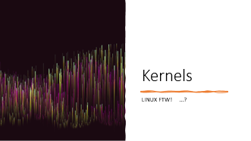
Summary

Slide 3

Link:
https://github.com/NewtonChutney/Public

Slide 4
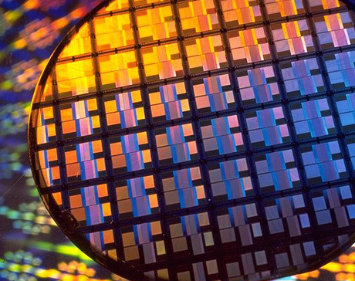
Steps in chip making
Silicon Fab is just one step

Slide 5
Steps
Specs
Arch design – HDL
Logic Design – RTL
Verif
Phy des – floormapping
Ver - pin
Fabbing
Notes:
LTT memory video – Micron factory
Tenstorrent risc-v chips

Slide 6

Probing.. LTT @ Micron

Slide 7
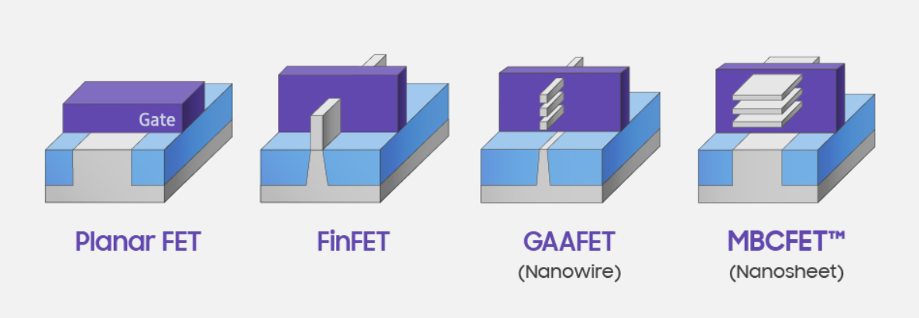
Silicon Lithography
Notes:
Quiz: major elements used in chip manufacturing..?

Slide 8
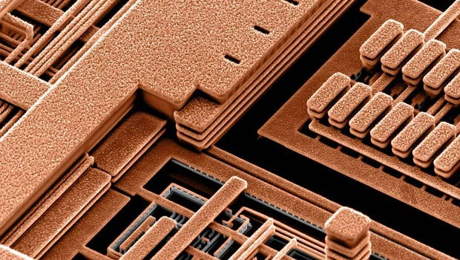
There are indeed copper wires in Si chips!!
https://www.chiphistory.org/ibm-s-development-of-copper-interconnect-for-ics

Slide 9
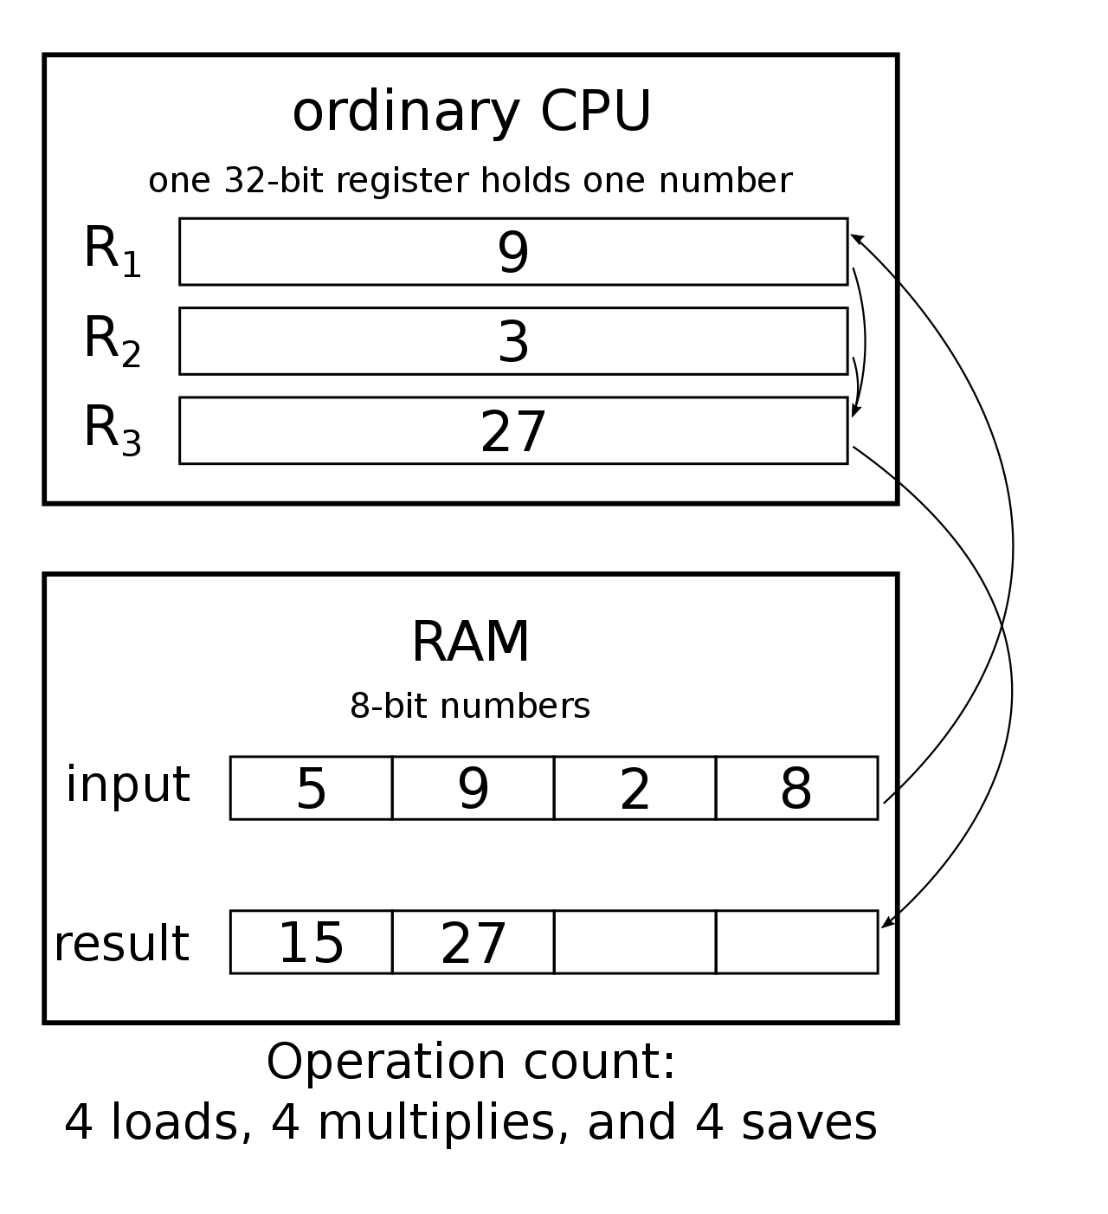
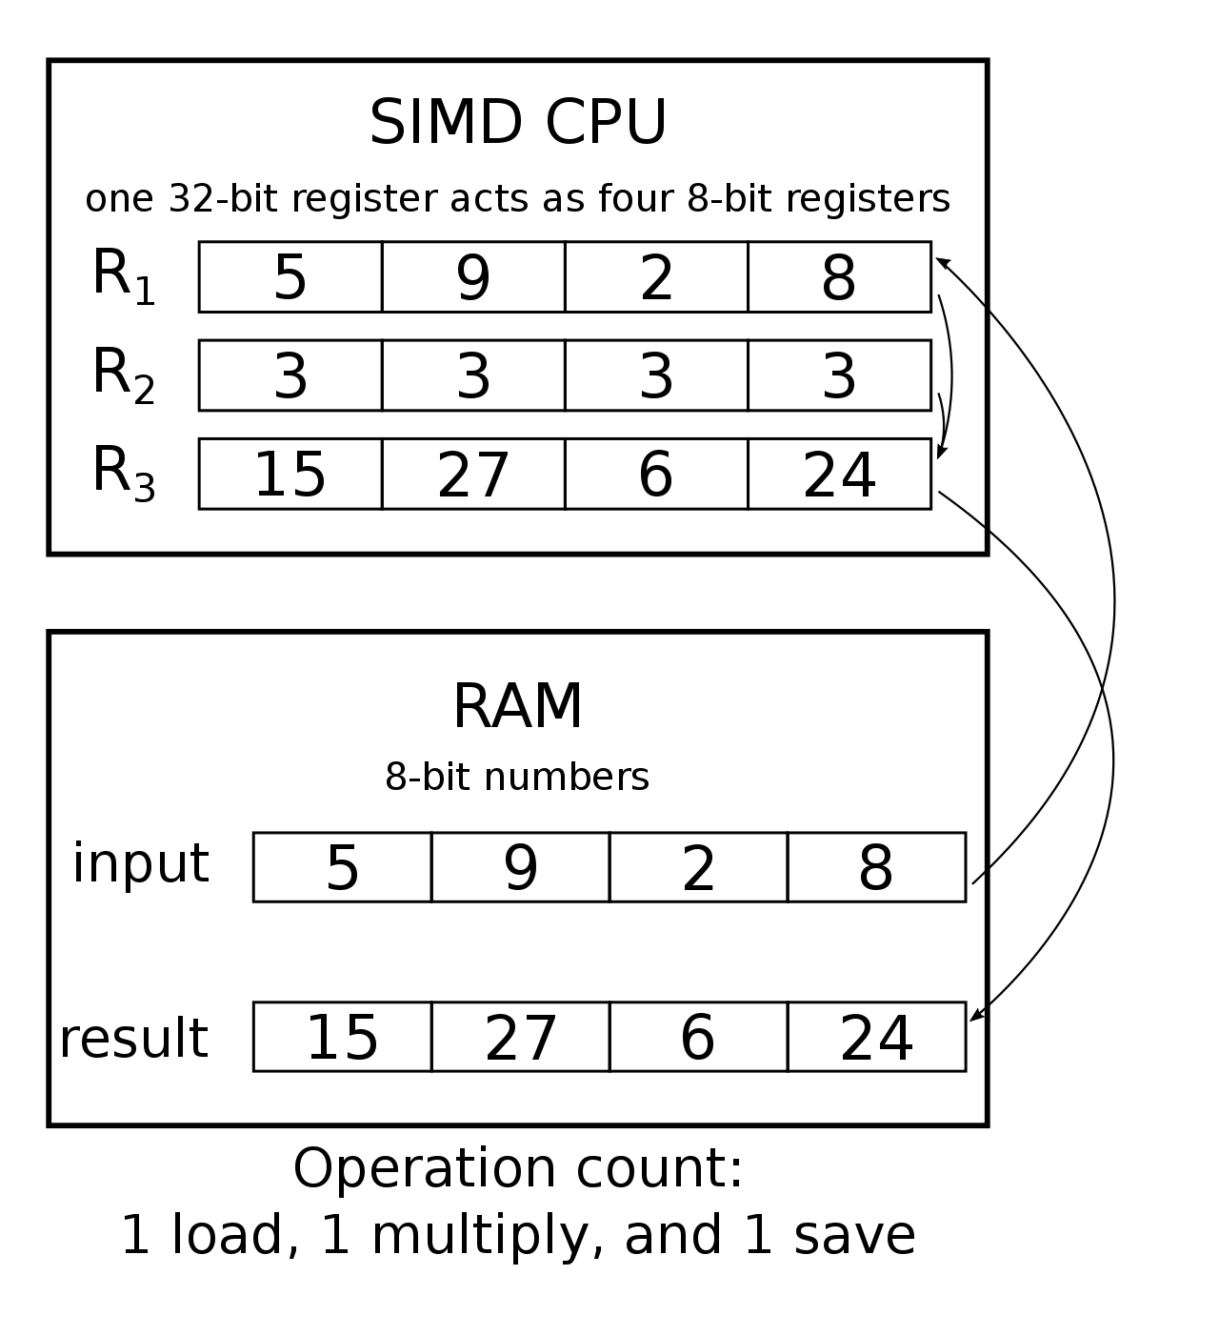
x86 vs ARM vs RISC-V
Vector/ SIMD https://en.wikipedia.org/wiki/Single_instruction,_multiple_data
Virtualization extensions
Royalties

Slide 10
ARM <v9 vs v9
<9
Extensibility basically forbidden
V9
You gotta pay

Slide 11
12th Gen chip
https://www.reddit.com/r/intel/comments/skmgae/intel_i9_13900k_raptor_lake_s_die_annotations/
https://hothardware.com/reviews/intel-architecture-day-2021
ARM has been doing heterogenous compute for quite a few years.. Why are the x86 companies struggling?
The names say it all… RISC vs CISC [ additional instructions not available on E cores: AVX-2, AVX512, ISA incompatibility between P n E cores]

Slide 12
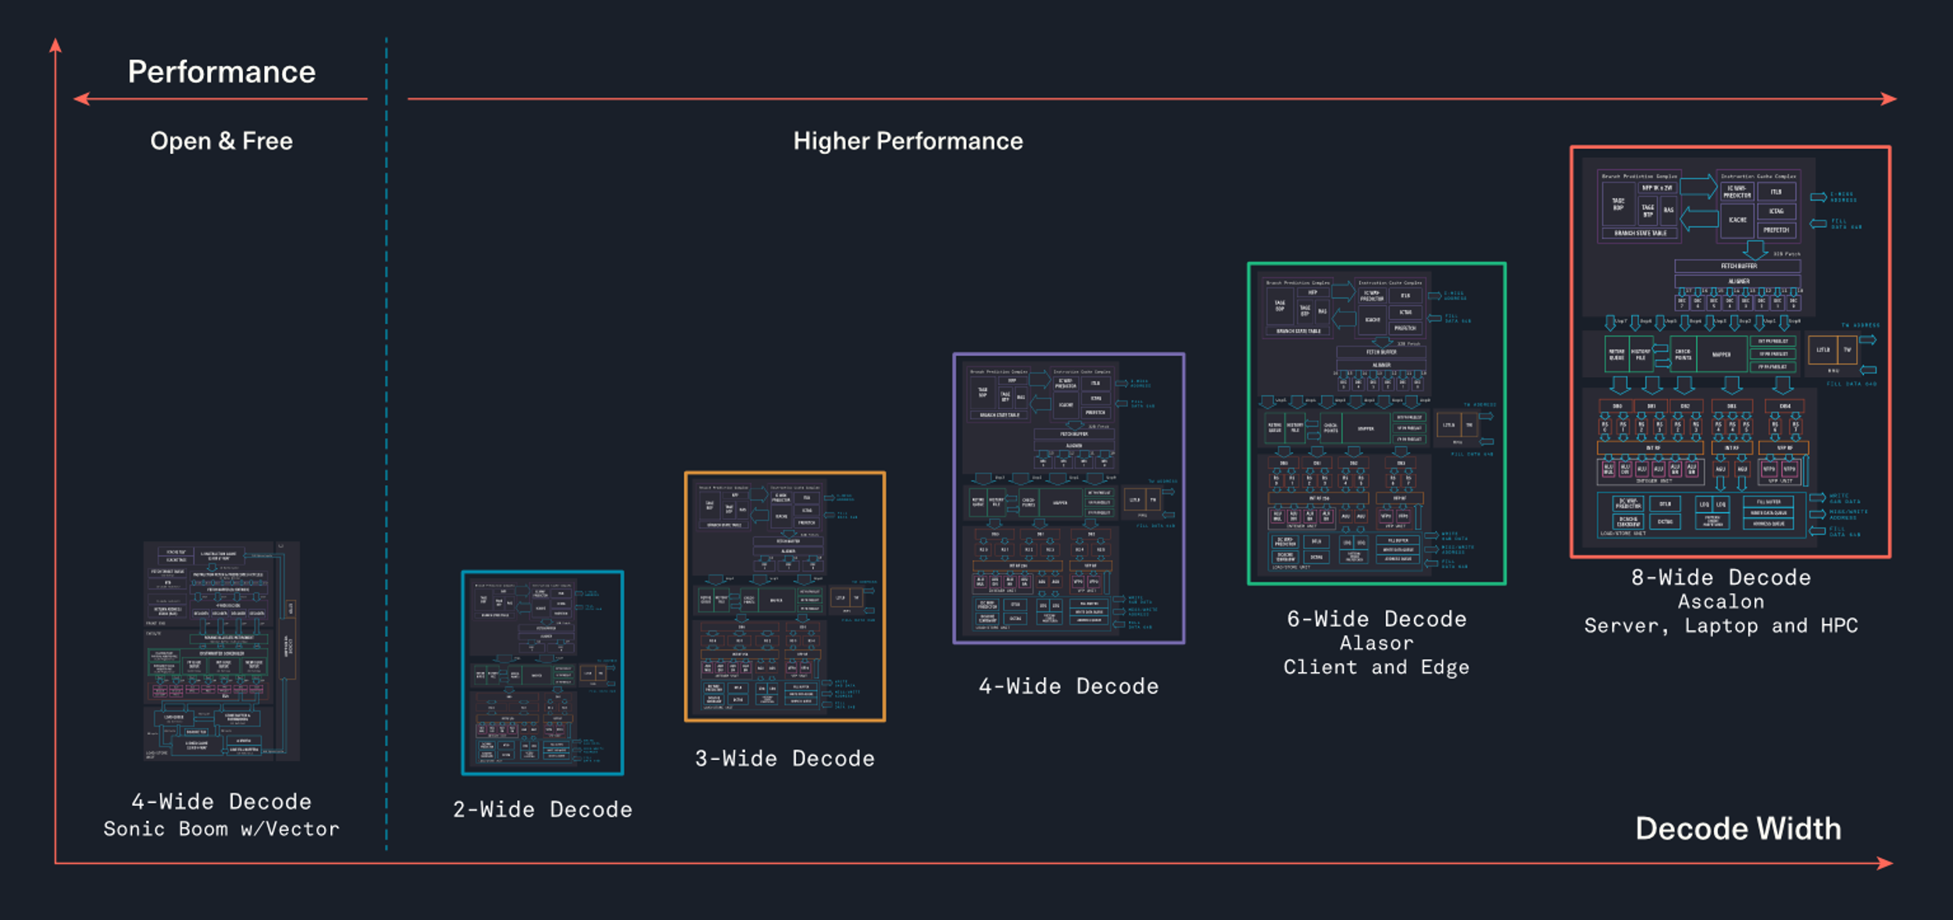
tenstorrent

Slide 13
Compute capabilities
~ 1990 .. costly memory.. Efficient programming
As memory became cheaper, gave way to GC enabled languages
Nowadays, as datacentre capacities are being maxed out
More efficient programming returns
More control for crucial apps required

Slide 14

Compilers
GCC is the best!! …..?? 🤔

Slide 15
Code licenses
GNU GPL vs MIT/Apache license

Slide 16
LLVM
Swift uses this!
Rust uses this!
"Clang" compiler

Slide 17
MUSL
Alpine Linux – docker hub images
Primary choice for containerized apps

Slide 18
Cloud – dockerized applications
K8s - Google
Alternatives:
containerd
podman
vagrant
Unikernels
https://www.nanovms.com/learn/docker-vs-unikernels

Slide 19
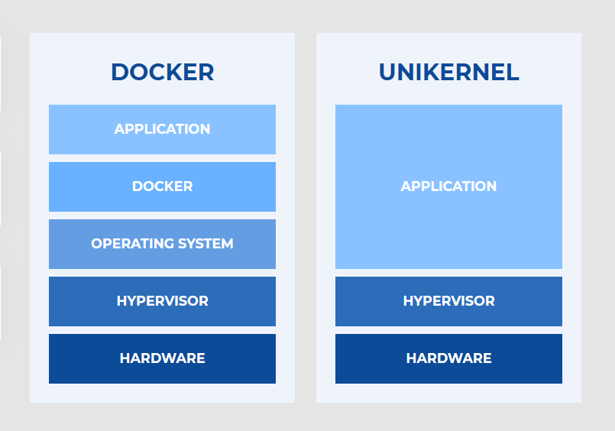

Slide 20
Unikernels vs Containers
Kubernetes and Docker are way slower than Linux because they duplicate both the storage and networking layers.
NanoVMs Nanos relies on the underlying infrastructures existing network primitives so it isn't just faster than containers - it's faster than Linux itself.
Unikernels can run 2X as fast as Linux on GCP and 3X as fast on AWS.
Unikernels remove layers of abstractions while containers add them.
Unikernels use the cloud as the orchestration platform and don't require an external one like K8S.
Unikernels are way easier to debug than containers.

Slide 21

Kernels
LINUX FTW! ...?

Slide 22
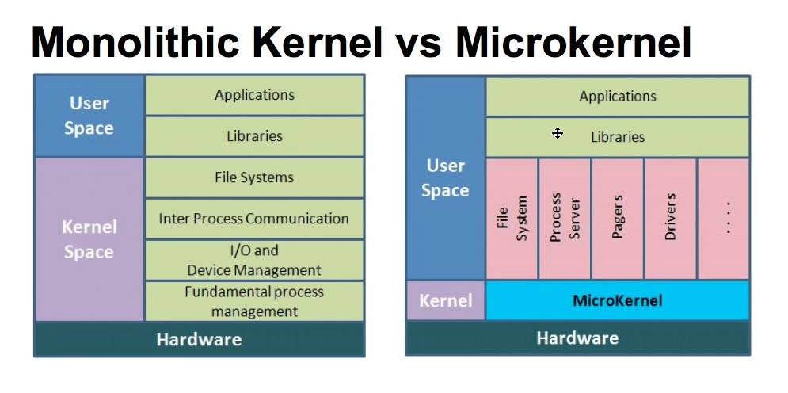
Monolithic vs micro

Slide 23
microkernel
BB10 – Android translation layer
Only till 4.4 API
Redox
Notes:
Redox, QNX

Slide 24
hybrid
the Environment subsystem and the Integral subsystem.
There are three main environment subsystems: the Win32 subsystem, an OS/2 subsystem and a POSIX subsystem.
The integral subsystem looks after operating system specific functions
It consists of a security subsystem, a workstation service and a server service.
Ref:
https://microsoft.fandom.com/wiki/Architecture_of_Windows_NT#:~:text=The%20user%20mode%20is%20made%20up%20of%20subsystems%20which%20can%20pass%20I/O%20requests%20to%20the%20appropriate%20kernel%20mode%20drivers%20via%20the%20I/O%20manager%20(which%20exists%20in%20kernel%20mode).%20%5Bcitation%C2%A0needed%5D%20Two%20subsystems%20make%20up%20the%20user%20mode%20layer%20of%20Windows%20NT%3A%20the%20Environment%20subsystem%20and%20the%20Integral%20subsystem.
https://microsoft.fandom.com/wiki/Architecture_of_Windows_NT#:~:text=The%20integral%20subsystem%20looks%20after%20operating%20system%20specific%20functions%20on%20behalf%20of%20the%20environment%20subsystem.%20%5Bcitation%C2%A0needed%5D%20It%20consists%20of%20a%20security%20subsystem%2C%20a%20workstation%20service%20and%20a%20server%20service.

Slide 25
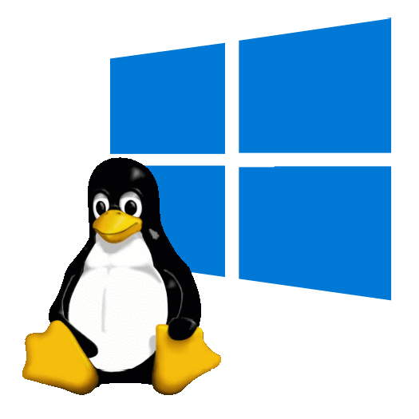
WSL
The Windows Subsystem for Linux (WSL) lets developers install a Linux distribution (such as Ubuntu, OpenSUSE, Kali, Debian, Arch Linux, etc) and use Linux applications, utilities, and Bash command-line tools directly on Windows.

Slide 26

Programming trends

Slide 27
Rewritten tools
nmap
vim
Grep
cloudflare
Adobe flash player
Npm
Discord
Dropbox
AWS sdk
Javascript runtime - Deno
Malware in RUST!!!!

Slide 28

Rust in Arts: Lighting effects

Slide 29
Rust in arts: RGB Sphere

Slide 30

WASM
WebAssembly (abbreviated Wasm) is a binary instruction format for a stack-based virtual machine. Wasm is designed as a portable compilation target for programming languages, enabling deployment on the web for client and server applications.

Slide 31
devcontainers

Slide 32
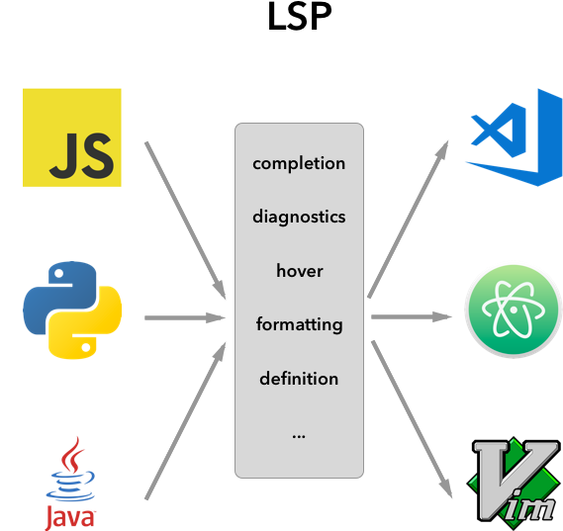
LSP
LSP
The Language Server Protocol (LSP) is an open, JSON-RPC-based protocol for use between source code editors or integrated development environments (IDEs) and servers that provide programming language-specific features like code completion, syntax highlighting and marking of warnings and errors, as well as refactoring routines.
Developed by vscode but now an open standard

Slide 33

Helix ……. A post-modern editor

Slide 34
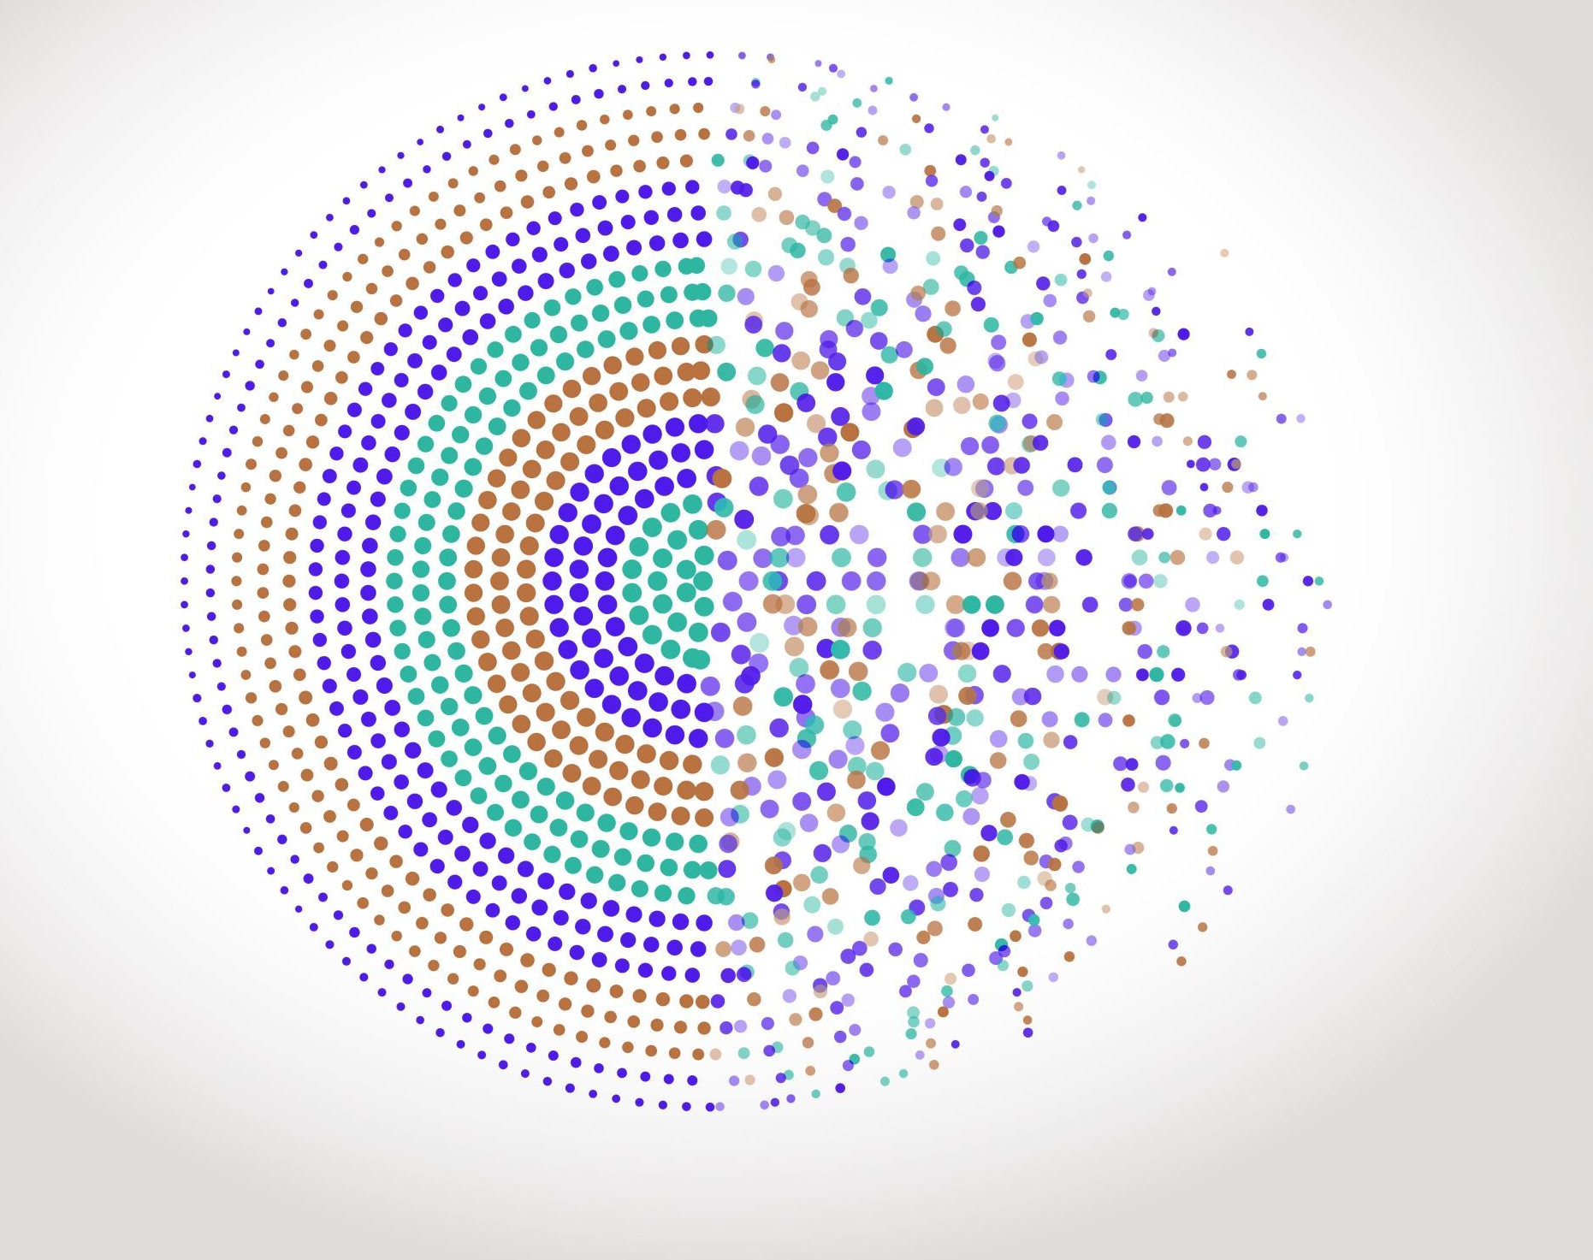
Companies that are doing great things

Slide 35

AI/ML in chip design
Cadence
Synopsys

Slide 36
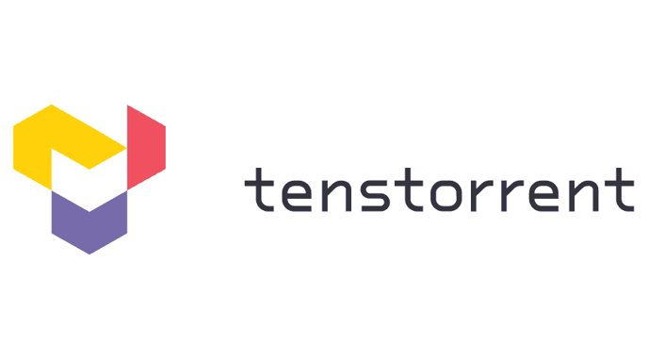

Slide 37
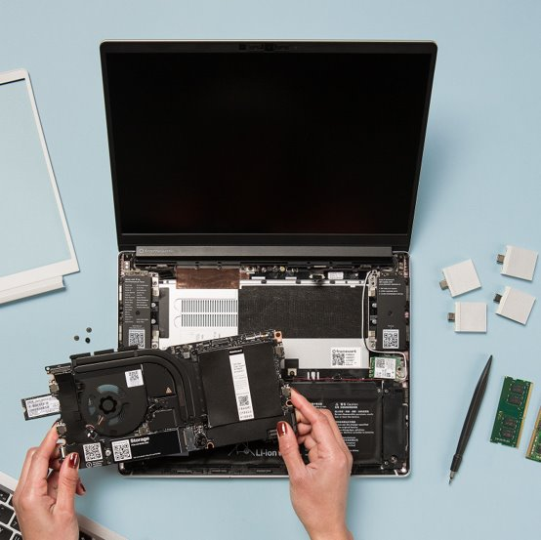

Framework makes thing and lightweight laptops that are modular. This includes CPUs, RAM, storage, Battery, and even Ports!!
Notes:
Discussion : vs System76 (POP-OS)
Nirav Patel – LTT –
Which processor to buy… Whichever you want! Which one would you buy.. Whichever like

Slide 38

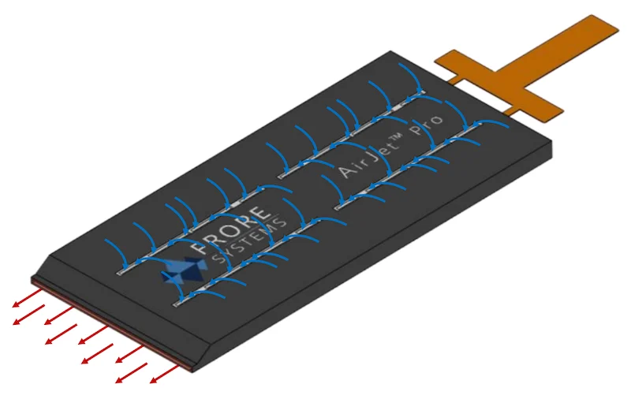
AirJet - Solid State Cooling tech
Frore systems
Notes:
Discussion : vs System76 (POP-OS)
Nirav Patel – LTT –
Which processor to buy… Whichever you want! Which one would you buy.. Whichever like

Slide 39

Youtube Channels/Videos to watch

Slide 40

Videos
Oscilloscope music: https://youtu.be/4gibcRfp4zA

Slide 41
Nostalgia Nerd
https://www.youtube.com/playlist?list=PLGh8hUWk1weyTFRDwTJvjux84d29x9C_Y
The Troubled Origins of .ZIP
Windows' Hidden Self Destruct Code (AARD)
Did Microsoft Steal Disk Compression?
https://www.youtube.com/playlist?list=PLGh8hUWk1wexxKYclaHe9ySbZV1vJT34P
Why CTRL+ALT+DEL?
https://www.youtube.com/playlist?list=PLGh8hUWk1wexDv_bdObnmUsL_w3uobY_U
https://youtu.be/qlp7jGxWHgI - Intel Movie

Slide 42
No BoilerPlate
https://www.youtube.com/watch?v=9K20e7jlQPA : Agile != Scrum
https://www.youtube.com/playlist?list=PLZaoyhMXgBzoM9bfb5pyUOT3zjnaDdSEP : Rust Talks

Slide 43
Low level Learning
https://youtu.be/11raTwzQVn4 - Why Rust is Being Used for Evil
https://youtu.be/zFELcHTki9U - Zig vs Rust vs C++
https://youtu.be/DdVC1eVfZUI - Reverse engineering

Slide 44

Interesting uArchs
https://wccftech.com/tachyum-prodigy-universal-processor-whitepaper-up-to-6x-faster-nvidia-h100-30x-faster-intel-xeon-8380/
Emulation for x86, Arm, RISC-V Prodigy Runs
Prodigy supports software dynamic binary translation for other instruction set architectures (ISAs) that include x86, Arm, and RISC-V. x86 is the established data center processor, Arm is very prevalent for telco applications, and RISC-V is popular with academic institutions. The overhead for binary translation is approximately 30 - 40%, but Prodigy will be running approximately two times the frequency of competitive processors, so the performance should be similar to running native. Binary translation is intended to enable fast, easy out of-the-box evaluation and testing for customers and partners, with customers migrating to Prodigy’s native ISA for production deployments for maximum performance.
IBM Telum:
https://wccftech.com/ibm-z-next-gen-processor-detailed-telum-chip-7nm-process-22-5-billion-transistors-8-cores-beyond-5-ghz-clocks/
https://www.servethehome.com/ibm-z-telum-mainframe-processor-at-hot-chips-33/

Slide 45
Apple M-series x86 acceleration
Probably extra instructions to emulate x86 efficiently.. i.e., Non-standard ARM ISA..
Wouldn't it attract intel lawsuits if that was the case.. As x86 design licenses are only with Intel, AMD and one other entity..?

